Slide 1

CASTROL INDIA LIMITED:
AN INNOVATIVE DISTRIBUTION CHANNEL
GROUP 4

Slide 2

Contents
Background
Synopsis
SWOT Analysis
4Ps Analysis
Distribution Strategy
Alternate Positioning

Slide 3
Case Based questions
What are TWO major expansion options before Rai and his team? Discuss pros and cons of each
What is the basis of segmentation for MCOs? DO you find this basis practical or would suggest alternatives?

Slide 4
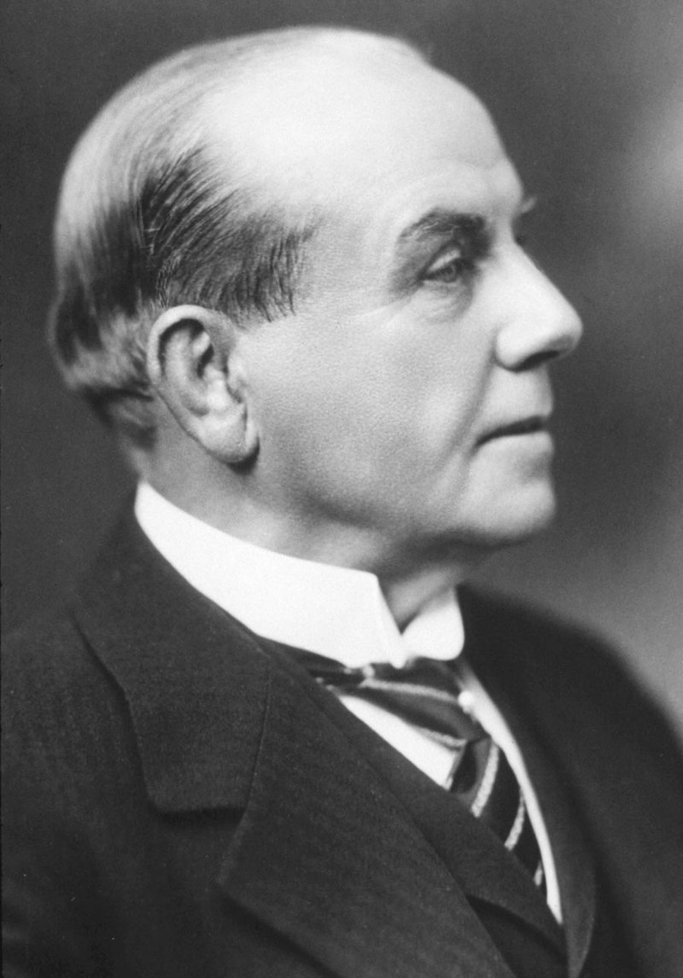
BACKGROUND
Castrol was founded in 1899 by Charles "Cheers" Wakefield as Wakefield's Oil Company in England with fame for its technological innovation and marketing expertise.
In 1906, Castrol launched its flagship product, Castrol Motor Oil, which quickly gained popularity due to its superior performance and quality.
The company invested heavily in research and development, leading to the introduction of innovative lubricants
The company sponsored numerous racing teams and events, including Formula 1, World Rally Championship, and motorcycle racing.

Slide 5
In 2002, Castrol was acquired by British Petroleum (BP), one of the world's largest energy companies
In 2008, Castrol launched its Marine Bio range with improved environmental performance to help protect ocean life
In 2012 NASA's Curiosity rover began its mission on Mars, lubricated by a Castrol grease
In 2017 Castrol launched its first bio-synthetic engine oil with 25% renewable plant-based oil.

Slide 6
SYNOPSIS
In 1970’s more than 90% sales occurred at retail forecourts, after government owned national oil companies took over forecourts, castrol cultivated and developed bazaar channel
In 2006 analysis, MCO 4T market growing by 17 to 18 million litres per year, Castrol only added 2.5 million litres , far less than market dominance suggested.
India-fast growing economy with expanding middle class and growth indicators pointed towards stable and market oriented economy.
In two-stroke lubricant mixed with gasoline, In four-stroke lubrication system is separate.

Slide 7
Changes in engine design - improved technology - smaller oil sump sizes - period between oil changes longer - stagnation in volume growth
Castrol covered a wide range of automotive and industrial applications.
Automotive portfolio - Engine oils, gear oils, transmission fluids, greases, coolants and brake fluids.
Industrial portfolio - Metal working oils, high-performance lubricants, corrosive preventives, industrial cleaning chemicals, hydraulic oils, gear oils, turbine oils, and general lubricating oils.
Factors driving this change - trust, convenience and personal attention from mechanic.
Three main channels of distribution - FWs, forecourts and bazaars. Most profitable - Bazaars.

Slide 8
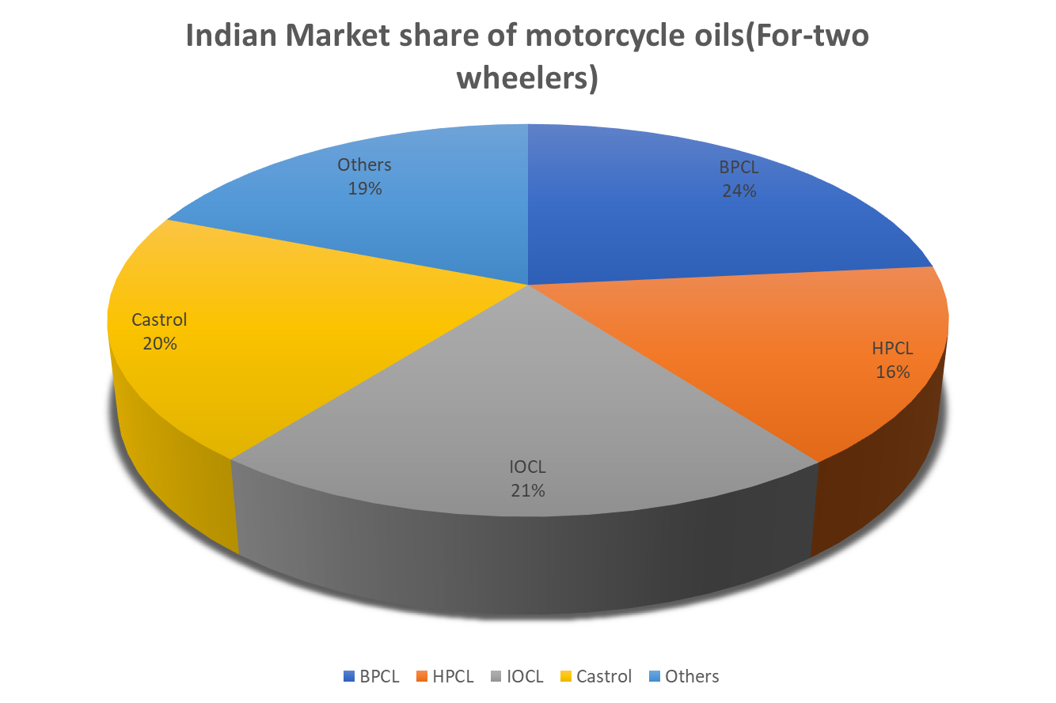

Slide 9
SWOT
ANALYSIS

Slide 10
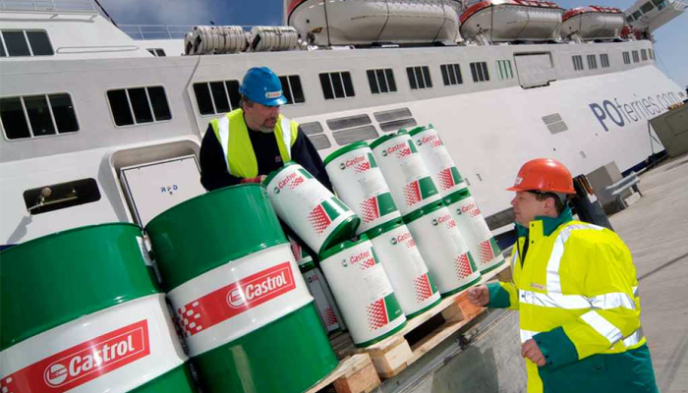
STRENGTH
Leading lubrication oil supplier globally, hence it is trusted brand in customer’s eyes.
Castrol has been in the Indian Market for more than 85 years, thus it has the knowledge & Experience in the Indian Market.
Castrol has a huge delivery network system extended across 140 Countries, 800 ports and 2000 Distributors and Agents.
Strong R&D team carry out Technological innovations in the Lubrication Oil Domain.
(Castrol’s Port Network)

Slide 11
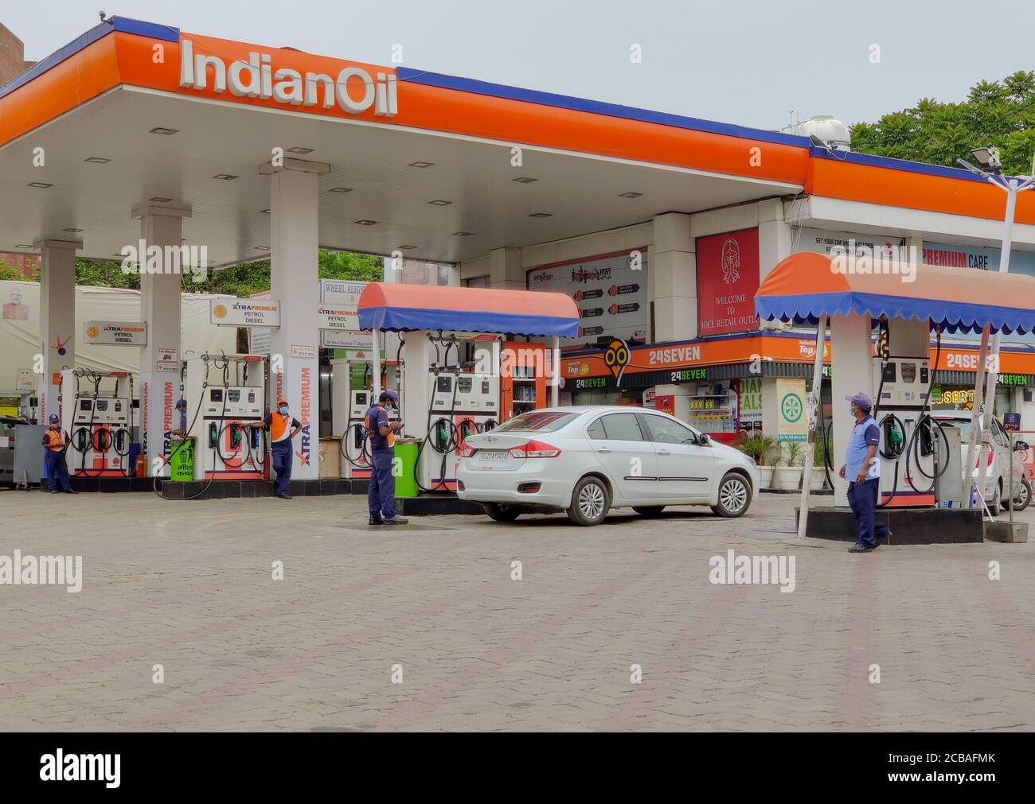
WEAKNESS
Forecourts were not allowed to market products from other companies than PSUs, so Castrol could not Market their products there.
PSUs were the Market leaders in the Two-Stroke Oil category.
Low coverage across after-Market channels.
(Forecourts owned by PSUs like IndianOil)

Slide 12
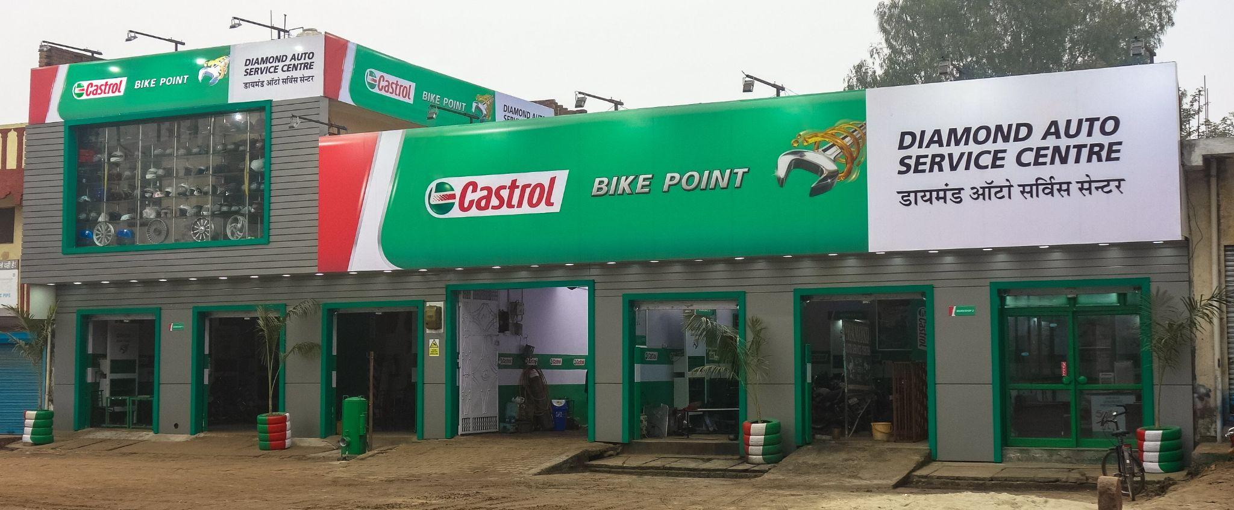
OPPORTUNITY
Potential to expand in Rural Parts of India.
Changing Market of Four-Stroke Lubricant Oil from Forecourts to Open Market.
The Changing behaviour of Customer to Trust the Workshop Mechanics to choose the lubricant Oil than choosing it themselves.
Focus on Growth through Partnership with the NFWs(Non Franchise Workshops).
Shifting from Selling Products to Selling Services.
(Castrol Service Centre)

Slide 13
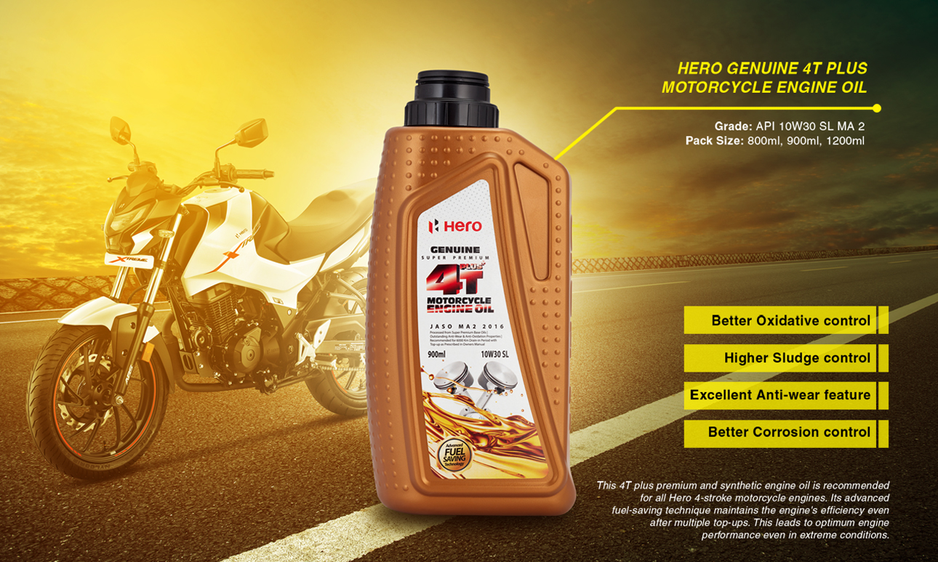
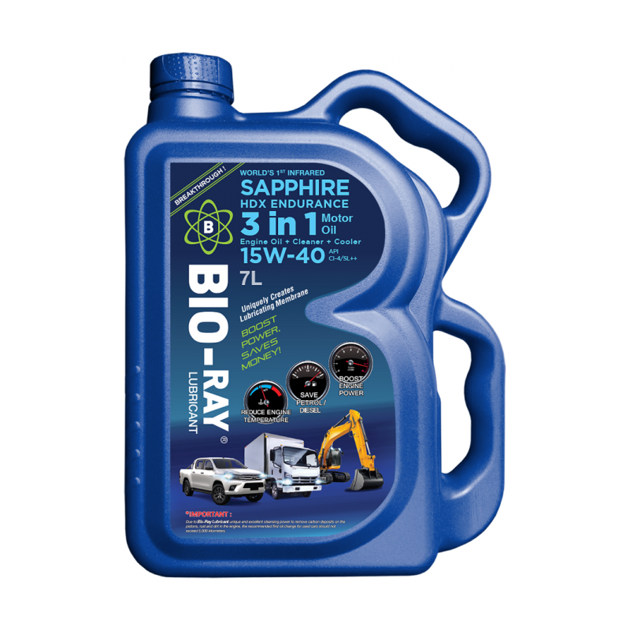
THREAT
PSUs setting up distribution channels & trying to increase their Market shares by offering discounts and better credit terms.
Growth of “Genuine Oils” which was sold by motorcycle Companies (like, Hero Honda 4T) through their own Dealerships and Bazaar Trade.
Newer Technologies emerging and the threat of being replaced by them (like Biobased lubricants and greases).
Giving Oil to NFWs on Credit.
Over dependence on Fossil Fuel which are exhausting rapidly.
(“Genuine Oils” by Hero Honda 4T)
(Biobased lubrication oil
by Sapphire)

Slide 14
4P ANALYSIS

Slide 15
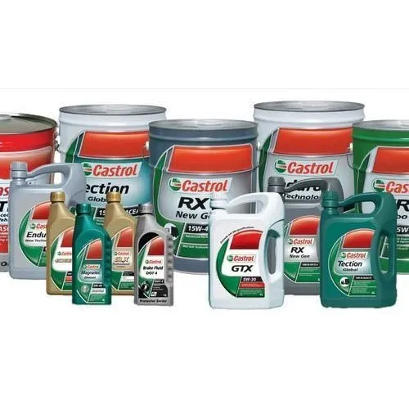
Product
Has properly segmented products on basis of vehicle needs.
Uses similar naming strategies for its products like Castrol Power1 Ultimate, Castrol Activ. (Umbrella Branding)
Offers products focused more on the vehicle health.

Slide 16
Pricing
Castrol has a price premium of 15-18% over competitors
Castrol offers its products in various packagings thus prices vary accordingly.
Prices were largely affected by change in technology.

Slide 17
Motorcycle Engine Oil (20W-40) (1L)
Product | Price(Rs.)
IOCL(SERVO 40) | Rs 440
BPCL(MAK 40 plus) | Rs 422
Castrol(Castrol Activ 40) | Rs 469
HPCL(Racer 4 ) | Rs 380
Car Engine Oil (5W-30)(3.5L)
Product Name | Price(Rs.)
IOCL(SERVO Futura G Plus) | Rs 1958
BPCL(MAK Classic Plus) | Rs 1531
Castrol(Castrol magnatec) | Rs 2526
HPCL(Neosynth) | Rs 1637
Shell(Shell Helix) | Rs 2688

Slide 18
Place & distribution
Are associated with many Original Equipment Manufacturers(OEMs) which allows them to reach out potential customers.
Castrol focus more on after-market through local retailer and distributors as compared to forecourts and FWs.
Castrol also uses Non-Franchise Workshops to distribute its lubricant products like grease, coolants etc.

Slide 19
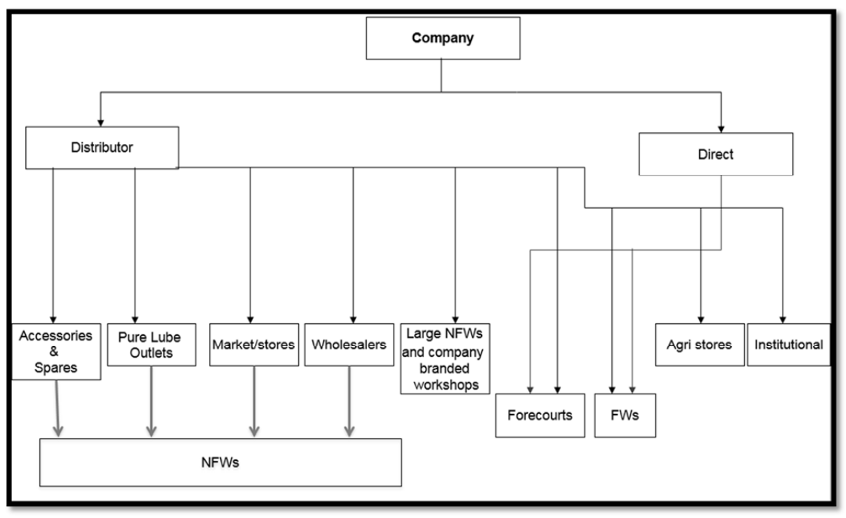
CHANNELS OF DISTRIBUTION FOR LUBRICANTS IN INDIA

Slide 20
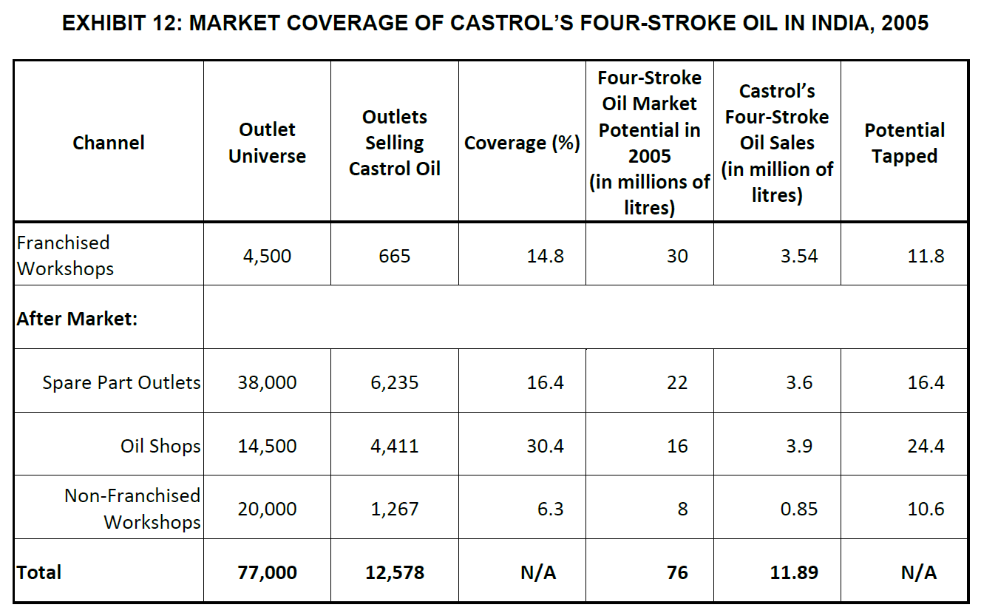

Slide 21
Castrol distribution expansion strategy 1
Appoint new channel of DSR to reach out to small and local NFWs
Pros:
small NFWs will receive credit,
Increased market reach
Cons:
Hiring DSR for each locality will incur high cost
ROI may be very less initially

Slide 22
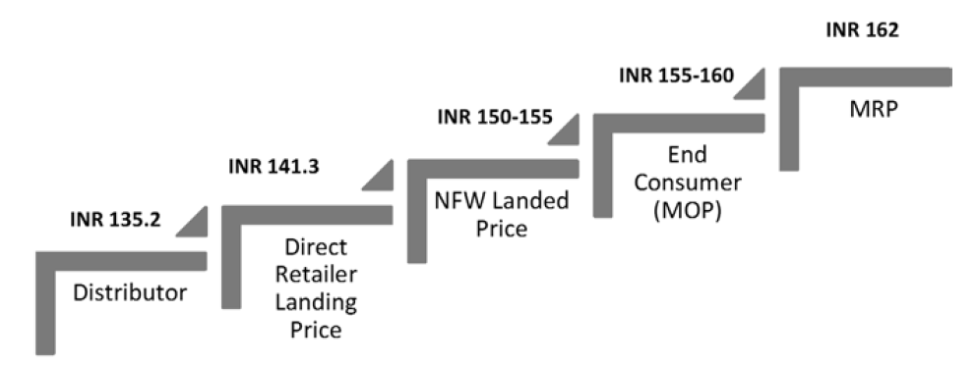
Castrol distribution expansion strategy 2
Directly supplying MCO to NFWs
Pros:
NFWs will receive more MCO at reduced price.
Cons:
Retail shops will have reduced sales

Slide 23
Promotion
Direct marketing through its retailers and workshop network to gain trust of customers.
Runs targeted media campaigns on television featuring celebrities with performer image.
Associates with motorsport teams in competition like F1, moto-GP, and Premier leagues.
Castrol is very much active and has a wide reach across all social media platforms
Notes:
Abcdefghij jhsfkdhfoiwef kdlfhw

Slide 24
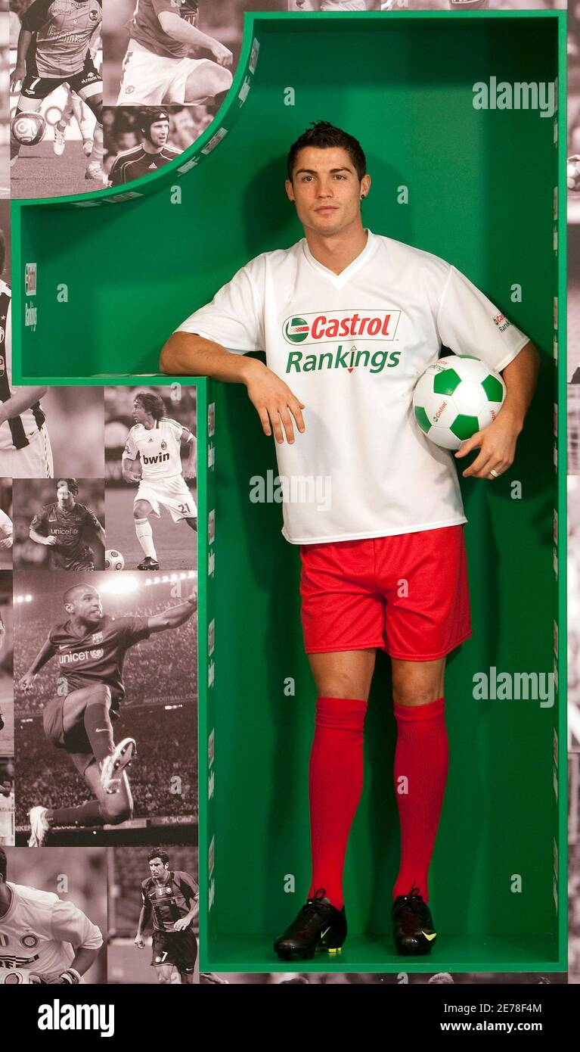
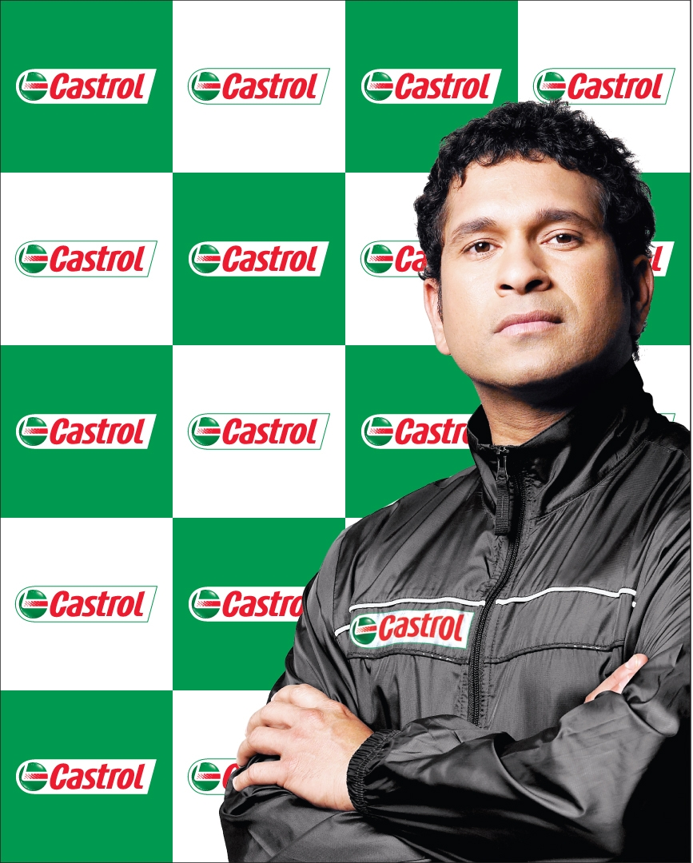
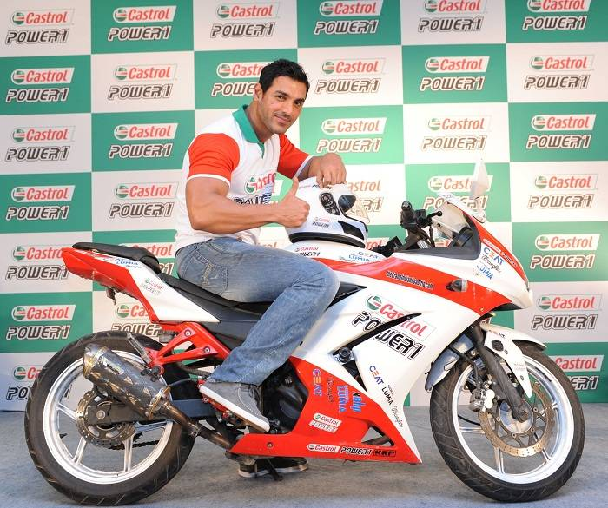

Slide 25
Castrol focused on different target consumer segments by running media campaigns for its different product ranges:
Castrol Power1 Ultimate: Roped in Tiger Shroff focusing on performance and youth
Castrol CRB : targeted truckers and farmers, focusing their health
Castrol Magnatec: Family audiences and SUV owners
Castrol Active: Regular two-wheelers for not comprising with cheap options

Slide 26
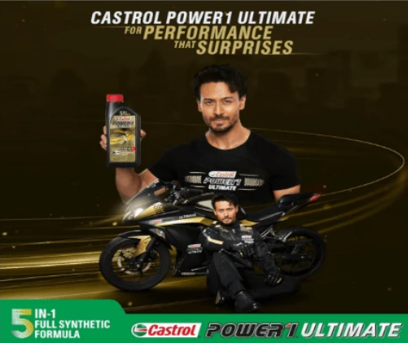
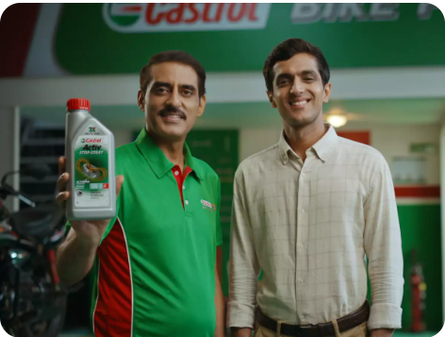
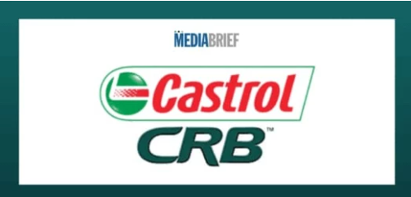
Castrol POWER1 ULTIMATE celebrated the adventurous and indomitable spirit of bikers with a new and catchy anthem
marketing campaign #CompromiseMehngaPadega demonstrating how Castrol Active offers superior protection to bike engines
campaign titled ‘India ka Engine, Andar se Strong’ was a tribute to all those farmers and truckers

Slide 27


Slide 28

Current Positioning:
Alternate Positioning:
Castrol: Serving India smoothly for a century
(Castrol can use its decades of experience to advertise loyalty and trust among customers)

Slide 29
THANK YOU

